Slide 1
QUANTIFYING UNCERTAINTY
(CHAPTER 13, Russell & Norvig)

Slide 2
This Lecture
Uncertainty
Probability
Syntax
Semantics
Inference rules
How to build a Naïve Bayes classifier

Slide 3
Uncertainty
Agents may need to handle uncertainty in their environment.
This can be due to partial observability, non-determinism, or a combination of the two.
Summarizing uncertainty/ uncertain reasoning using an example:
Diagnosing a dental patient’s toothache.
Consider the following simple rule:
Toothache ⇒ Cavity

Slide 4
Uncertainty cont.
Rule: Toothache ⇒ Cavity
This rule is incorrect
Not all toothache is caused by cavity
Toothache ⇒ Cavity ∨ Gum Problem ∨ Abscess ...
To make the rule true, we must add an almost unlimited list of possible problems
Therefore, to use logic fails for three main reasons:
Laziness: It is too much work to list the complete set of antecedents or consequents
needed to ensure an exceptionless rule and too hard to use such rules.
Theoretical ignorance: Medical science has no complete theory for the domain.
Practical ignorance: Even if we know all the rules, we might be uncertain about a particular patient because not all the necessary tests have been or can be run.

Slide 5
Uncertainty cont.
Connection between toothaches and cavities is not a logical consequence
The agent’s knowledge can at best provide only a degree of belief in the relevant sentences.
The main tool for dealing with degrees of belief is probability theory.
Probabilities express the agent’s inability to reach a definite decision regarding the truth of a sentence.
Probabilities summarize the agent’s beliefs relative to the evidence.

Slide 6
Solution using probability theory:
We believe the patient has 80% chance, probability of 0,8 that the patient who has a toothache has a cavity.
We expect that out of all the situations the patient will have a cavity in 80% of them.
This belief could be derived from statistical data such as:
80% of the toothache patients seen so far have had cavities
or from some general dental knowledge
or from a combination of evidence sources.

Slide 7
Uncertainty and rational decisions
Action plans with probabilities
P(A90 gets me there on time/…) = 0.70
P(A180 gets me there on time/…) = 0.95
P(A1440 gets me there on time/…) = 0.999
A90 plan gives us a 70% chance of catching our flight.
Not a rational choice. Why?
Because A180, which has a higher probability only if it is vital not to miss the flight, then it is worth risking the longer wait at the airport.
A1440, a plan that involves leaving home 24 hours in advance. In most circumstances, this is not a good choice, because although it almost guarantees getting there on time, it involves an intolerable wait.

Slide 8
Rational Approach cont.
Therefore, AGENT needs PREFERENCE of which possible outcome it prefers among the various plans.
Outcome is a completely specified state, including such factors as:
Whether the agent arrives on time and
The length of the wait at the airport.
So, to represent and reason with preference we use UTILITY THEORY.
UTILITY used in this context is “the quality of being useful,” / practical.

Slide 9
Rational Approach cont.
UTILITY THEORY:
Every state has a degree of usefulness/ utility to an agent
Agent will prefer states with higher utility
The utility of a state is relative to an agent.
Preferences, that are expressed by utilities, are combined with probabilities in the general theory of rational decisions called decision theory:
Decision theory = probability theory + utility theory
The fundamental idea of decision theory is that an agent is rational if and only if it chooses the action that yields the highest expected utility, averaged over all the possible outcomes of the action

Slide 10
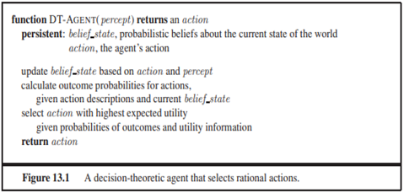

Slide 25

Probabilities
Probabilistic assertions are about possible worlds
About how probable the various worlds are
Probability SAMPLE SPACE theory:
the set of all possible worlds is called the sample space
The possible worlds are mutually exclusive and exhaustive
For example, if we are about to roll two (distinguishable)
dice, there are 36 possible worlds to consider: (1,1), (1,2), ..., (6,6).
The Greek letter Ω – refers to sample space
ω (lowercase omega) refers to elements of the space
associates a numerical probability P(ω) with each possible world
every possible world has a probability between 0 and 1 and that the total probability of the set of possible worlds is 1

Slide 26
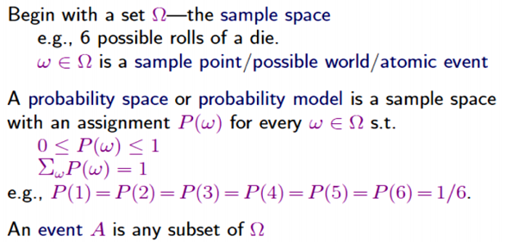
Probability basics

Slide 27
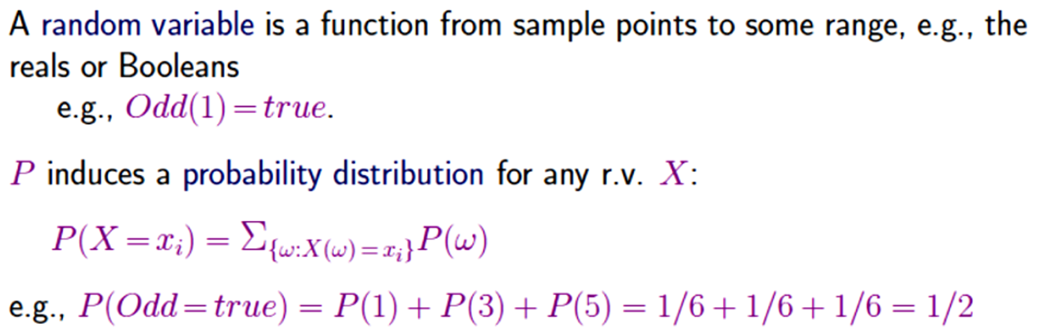
Propositions
Propositions describing sets of possible worlds are written in a notation that combines elements of propositional logic.
Possible world is represented by a set of variable/value pairs.
Variables in probability theory are called random variables and their names begin with an uppercase letter.

Slide 28
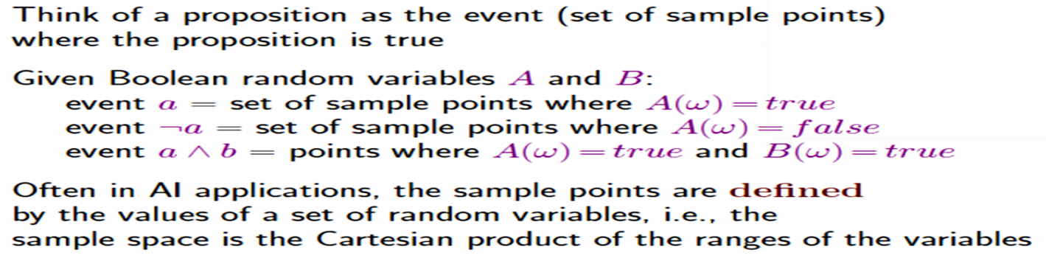
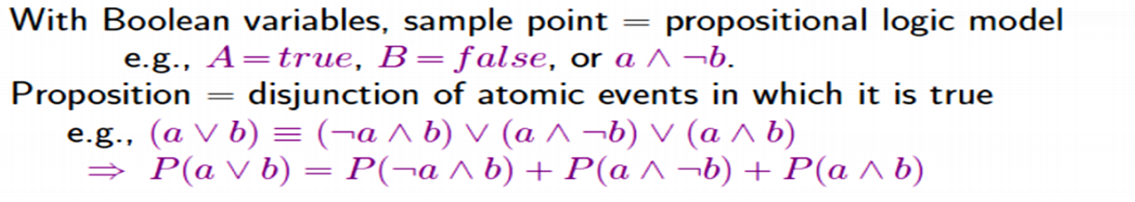

Slide 29
Syntax for propositions
DOMAINS
Random variables has domains
Domain is a set of possible values it can take on
Domain for Age to be {juvenile, teen, adult} and the
Domain of Weather might be {sunny, rain, cloudy, snow}.
These are known as the finite domain.
Variables can have infinite domains:
discrete (like the integers) or
continuous (like the reals)

Slide 30
DOMAINS cont.
Boolean random variable:
Domain {true, false}
Values are always lowercase
for example, the proposition that doubles are rolled can be written
Doubles = true

Slide 31
Domain cont.
Sometimes we will want to talk about the probabilities of all the possible values of a random
variable. We could write:
P(Weather = sunny)=0.6
P(Weather = rain)=0.1
P(Weather = cloudy)=0.29
P(Weather = snow)=0.01 ,
but as an abbreviation we will allow P(Weather ) = {0.6, 0.1, 0.29, 0.01},
The bold P indicates that the result is a vector of numbers, and where we assume a predefined ordering sunny, rain, cloudy, snow on the domain of Weather .
We say that the P statement defines a probability distribution for the random variable Weather . The P notation is also used for conditional distributions: P(X | Y ) gives the values of P(X = xi | Y = yj ) for each possible i, j pair

Slide 32
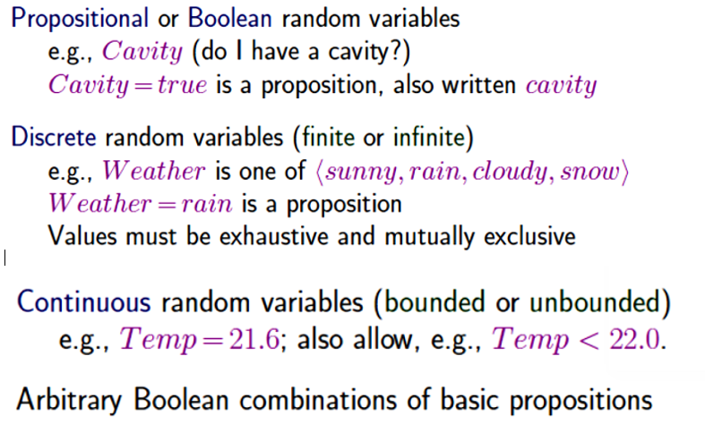
Syntax for propositions cont.

Slide 33
Unconditional probabilities
simply the probability of an event occurring.
probability of an event that is not conditioned on the occurrence of another event.
It is expressed as P(A).

Slide 34
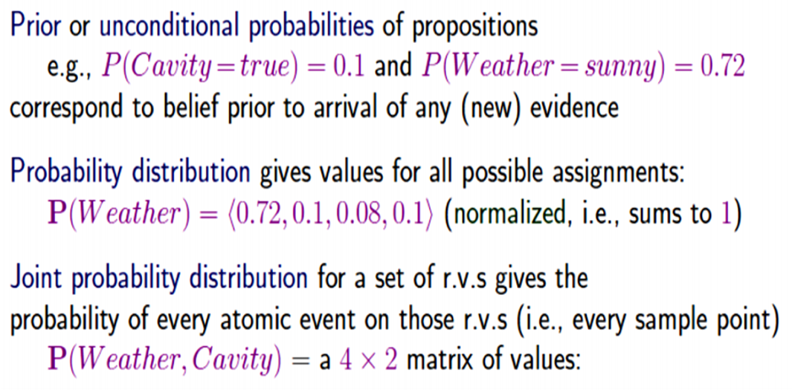
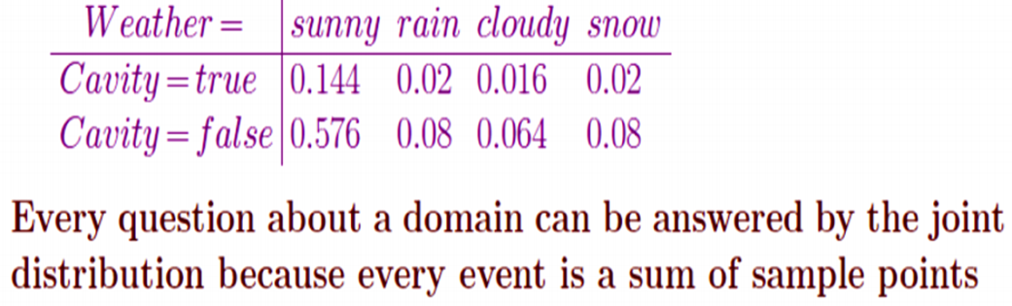

Slide 35
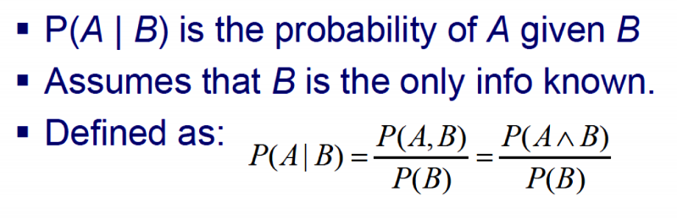
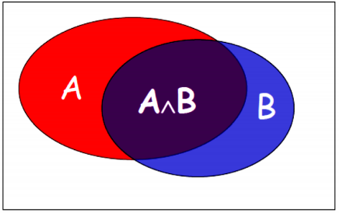
Conditional/ Posterior probability
probability of an event given that another event has occurred.
It is denoted as P(A | B) ("the probability of A given B").
conditional probabilities are defined in terms of unconditional probabilities:
I.e., P(A|B) means, our universe has shrunk to the one in which B is true.
P(A|B) is the ratio of the red area to the blue area.

Slide 36
Conditional Probability cont.
The definition of conditional probability, Equation can be written in a different PRODUCT RULE form called the product rule:
P(a ∧ b) = P(a | b)P(b) ,
The product rule is perhaps easier to remember it comes from the fact that, for a and b to be true, we need b to be true, and we also need a to be true given b.

Slide 37
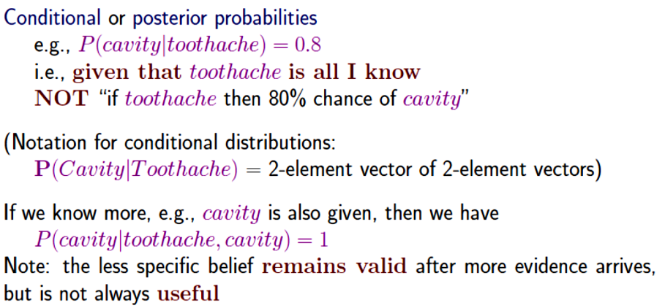
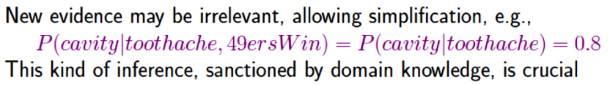

Slide 38
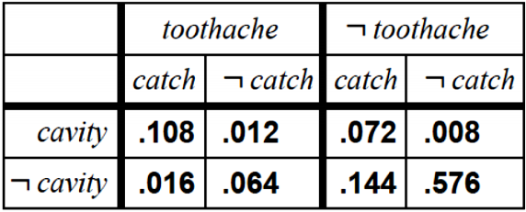
Inference using full joint distributions
We begin with a simple example:
What is the probability of a cavity giving a toothache?
What is the probability of a cavity given the probe catches?
Three random variables (R.V’s) each either True or False:
Cavity, toothache, catches
Start with the joint distribution:

Slide 39
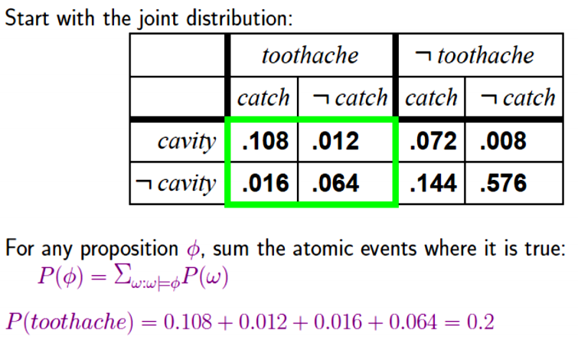
Inference using full joint distributions cont.

Slide 40
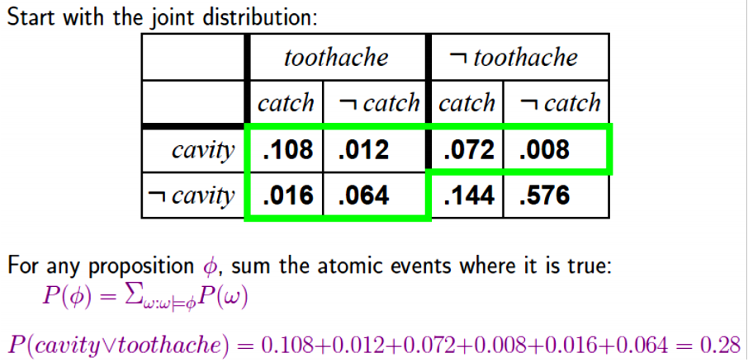
Inference using full joint distributions cont.

Slide 41
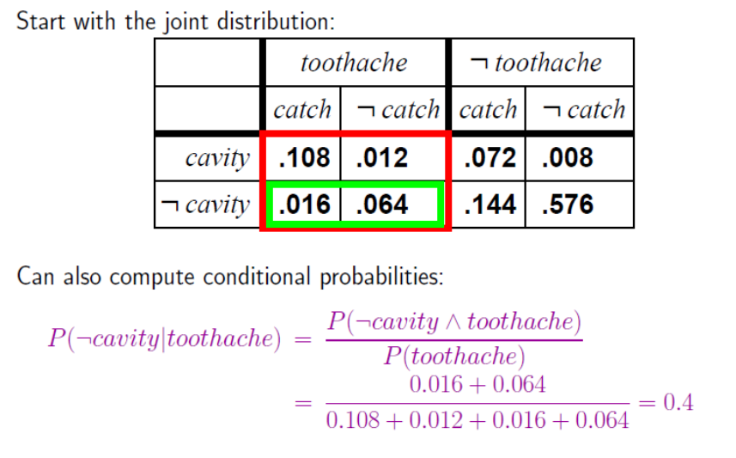
Inference using full joint distributions cont.

Slide 42
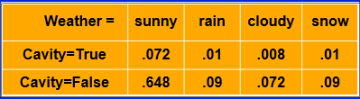
The importance of independence
P(Weather, Cavity) is a 4 by 2 matrix of values:
But these are independent (usually):
Recall that if X and Y are independent then:
P(X=x,Y=y) = P(X=x)*P(Y=y)
Weather is one of <sunny,rain,cloudy,snow>
P(Weather) = <0.72, 0.1, 0.08, 0.1> and P(Cavity) = .1

Slide 43
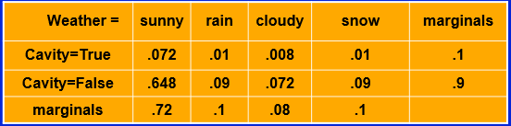
The importance of independence cont.
If we compute the marginals (sums of rows or columns), we see:
Each entry is just the product of the marginals (because they’re independent)!
So, instead of using 7 numbers, we can represent these by just recording 4 numbers, 3 from Weather and 1 from Cavity:
Weather is one of <sunny,rain,cloudy,snow>
P(Weather) = <0.72, 0.1, 0.08, (1- Sum of the others)>
P(Cavity) = <.1, (1-.1)>
This can be much more efficient (more later…)

Slide 44


Bayes Rule
From product rule P(A^B) = P(A|B)P(B) = P(B|A)P(A), we can obtain Bayes' rule
Why is this useful???
For assessing diagnostic probability from causal probability:
e.g., Cavities as the cause of toothaches Sleeping late as the cause for missing class Meningitis as the cause of a stiff neck

Slide 45


Bayes Rule: Example
Let M be meningitis, S be stiff neck
P(M)=0.0001 P(S)= 0.1 P(S | M) = 0.8
Note: posterior probability of meningitis still very small!

Slide 46
Bayes Rule: Another Example
Let A be AIDS, T be positive test result for AIDS
P(T|A)=0.99 “true positive” rate of test (aka a “hit”)
P(T|~A)= 0.005 “false positive” rate of test (aka a “false alarm”) P(~T | A) = 1-0.99=.01 “false negative” or “miss”
P(~T|~A) = 0.995 “correct rejection”
Seems like a pretty good test, right?

Slide 47
Bayes Rule: Another Example
Let A be AIDS, T be positive test result for AIDS
P(T|A)=0.99 “true positive” rate of test (aka a “hit”)
P(T|~A)= 0.005 “false positive” rate of test (aka a “false alarm”) P(~T | A) = 1-0.99=.01 “false negative” or “miss”
P(~T|~A) = 0.995 “correct rejection”
Now, suppose you are from a low-risk group, so P(A) = .001, and you get a positive test result. Should you worry?
Let’s compute it using Bayes’ rule: P(A|T) = P(T|A)*P(A)/P(T) Hmmm. Wait a minute: How do we know P(T)?
Recall there are two possibilities: Either you have AIDS or you don’t. Therefore: P(A|T) + P(~A|T) = 1.
P(~A|T) = P(T|~A)*P(~A)/P(T)
So, P(A|T) + P(~A|T) = P(T|A)*P(A)/P(T) + P(T|~A)*P(~A)/P(T) = 1

Slide 48
Bayes Rule: Another Example
P(A|T) = P(T|A)*P(A)/P(T)
Hmmm. Wait a minute: How do we know P(T)?
Recall there are two possibilities: Either you have AIDS or you don’t.
Therefore: P(A|T) + P(~A|T) = 1.
Now, by Bayes’ rule:
P(~A|T) = P(T|~A)*P(~A)/P(T)
So,
P(A|T) + P(~A|T) = P(T|A)*P(A)/P(T) + P(T|~A)*P(~A)/P(T) = 1
P(T|A)*P(A) + P(T|~A)*P(~A) = P(T)
The denominator is always the sum of the numerators if they are exhaustive of the possibilities - a normalizing constant to make the probabilities sum to 1!
We can compute the numerators and then normalize afterwards!

Slide 49

A generalized Bayes Rule
More general version conditionalized on some background evidence E

Slide 50
Absolute Independence
Two random variables A and B are (absolutely) independent iff
P(A, B) = P(A)P(B)
Using product rule for A & B independent, we can show:
P(A, B) = P(A | B)P(B) = P(A)P(B)
Therefore P(A | B) = P(A)
If n Boolean variables are independent, the full joint is:
P(X1, …, Xn) = i P(Xi)
Full joint is generally specified by 2n - 1 numbers, but when independent only n numbers are needed.
Absolute independence is a very strong requirement, seldom met!!

Slide 51
Conditional Independence
Some evidence may be irrelevant, allowing simplification, e.g.,
P(Cavity | Toothache, PadresWin) = P(Cavity | Toothache) = 0.8
This property is known as Conditional Independence and can be expressed as: P(X | Y, Z) = P(X | Z)
which says that X and Y independent given Z.
If I have a cavity, the probability that the dentist’s probe catches in it doesn't depend on whether I have a toothache:
1. P(Catch | Toothache, Cavity) = P(Catch | Cavity)
i.e., Catch is conditionally independent of Toothache given Cavity
This doesn’t say anything about P(Catch|Toothache)
The same independence holds if I haven't got a cavity:
2. P(Catch | Toothache, ~Cavity) = P(Catch | ~Cavity)

Slide 52
Conditional independence cont.
Equivalent statements to
P(Catch | Toothache, Cavity) = P(Catch | Cavity) ( * )
a. P(Toothache | Catch, Cavity) = P(Toothache | Cavity) P(Toothache | Catch, Cavity)
= P(Catch | Toothache, Cavity) P(Toothache | Cavity) / P(Catch | Cavity)
= P(Catch | Cavity) P(Toothache | Cavity) / P(Catch | Cavity) (from *)
= P(Toothache|Cavity)
b. P(Toothache,Catch|Cavity) = P(Toothache|Cavity)P(Catch|Cavity)
P(Toothache,Catch | Cavity)
= P(Toothache | Catch,Cavity) P(Catch | Cavity) (product rule)
= P(Toothache | Cavity) P(Catch | Cavity)

Slide 53
Using Conditional Independence
Full joint distribution can now be written as
P(Toothache,Catch,Cavity)
= (Toothache,Catch | Cavity) P(Cavity)
= P(Toothache | Cavity)P(Catch | Cavity)P(Cavity)
Specified by 2 + 2 + 1 = 5 independent numbers Compared to 7 for general joint or 3 for unconditionally independent.

